Slide 1
Understanding the Management Process

Slide 2
Learning Objectives
6-1 Define what management is.
6-2 Describe the four basic management functions: planning, organizing, leading and motivating, and controlling.
6-3 Distinguish among the various kinds of managers in terms of both level and area of management.
6-4 Identify the key management skills of successful managers.
6-5 Explain the different types of leadership.
6-6 Discuss the steps in the managerial decision-making process.
6-7 Describe how organizations benefit from total quality management.

Slide 3

What Is Management?
Management is the process of coordinating people and other resources to achieve the goals of an organization

Slide 4

Management Resources
Material resources are the tangible, physical resources an organization uses
Human resources are the people
who staff an organization and use
the other resources to achieve
the goals of the organization
Financial resources are the funds an organization uses to meet its obligations to investors and creditors
Information resources refers to the information about the external business environment the firm uses to its competitive advantage

Slide 5
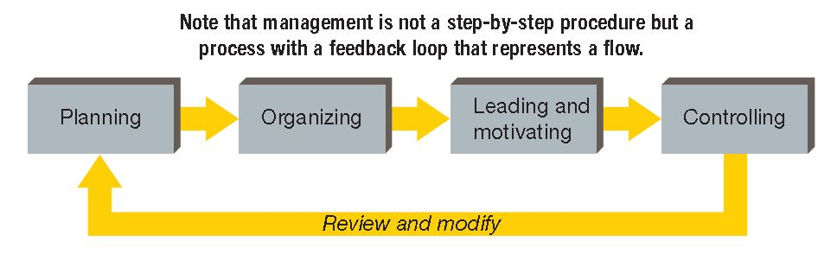
Basic Management Functions
How well managers perform these key management process functions determines whether a business is successful

Slide 6
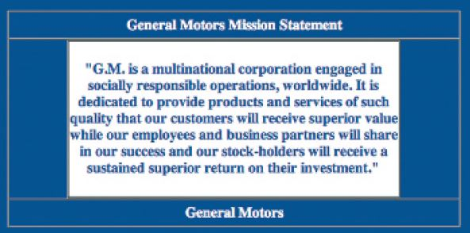
Planning
Planning is establishing organizational goals and deciding how to accomplish them
An organization’s mission is a statement of the basic purpose that makes the organization different from others

Slide 7
Planning: Strategic Planning Process
The strategic planning process involves establishing an organization’s major goals and objectives and allocating resources to achieve them
  Goal: An end result that an organization is expected to achieve over a one- to ten-year period
  Objective: A specific statement detailing what an organization intends to accomplish over a shorter period of time
Goals in different departments and at different levels may conflict—it is the manager’s job to achieve balance, which is called optimization

Slide 8
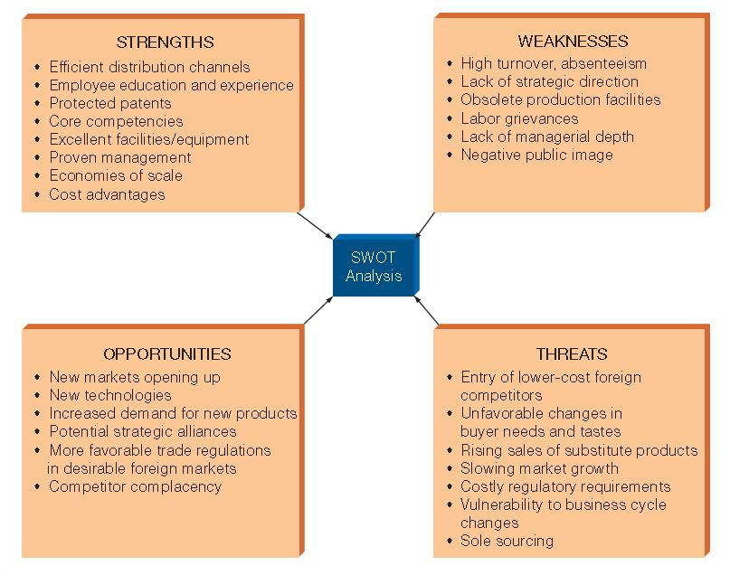
SWOT Analysis
SWOT analysis is the identification and evaluation of a firm’s strengths, weaknesses, opportunities, and threats

Slide 9
SWOT Analysis Components
Core competencies: Approaches and processes that give a company an advantage
Weaknesses: Internal limitations a company faces in developing or implementing plans
Opportunities: Situations that, if exploited, could produce rewards
for an organization
Threats: Conditions or barriers that may prevent the firm from reaching its objectives
© YABRESSE/SHUTTERSTOCK
Notes:
Additional Resources
The Globe and Mail (Canada): Corporate espionage versus competitive advantage (11/5/12)
http://www.theglobeandmail.com/report-on-business/careers/business-education/corporate-espionage-versus-competitive-intelligence/article4933482/
CBS Moneywatch
How to Gather Competitive Research (3/28/07)
http://www.cbsnews.com/8301-505125_162-51060253/how-to-gather-competitive-research/?tag=bnetdomain
CBS Moneywatch
Thou Shalt Not Steal Thy Competitor's Secrets (3/28/07)
http://www.cbsnews.com/8301-505125_162-51060254/thou-shalt-not-steal-thy-competitors-secrets/
Outward Insights
Ethics: The Limits of Intelligence Gathering
By Karen Rothwell, Outward Insights
http://www.outwardinsights.com/articles/0802_rothwell.pdf
Website/Organization
Strategic and Competitive Intelligence Professionals
http://www.scip.org/index.cfm

Slide 10
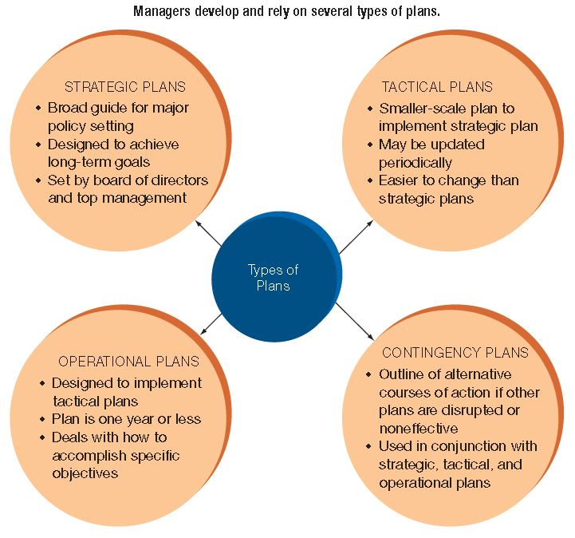
Types of Plans

Slide 11
Types of Plans: Strategic Plan
Broad guide for major policy setting
Designed to achieve long-term goals
Set by board
of directors
and top management
Strategic Plan
Goal

Slide 12
Types of Plans: Tactical Plan
Smaller-scale plan to implement strategic plan
May be updated periodically
Easier to change than strategic plans
Tactical Plan
Goal

Slide 13
Types of Plans: Operational Plan
Designed to implement tactical plans
Plan is one year or less
Deals with how to accomplish specific objectives
Operational Plan
Goal

Slide 14
Types of Plans: Contingency Plans
Strategic Plan
Tactical Plan
Operational Plan
Outline of alternative courses of action if other plans are disrupted or noneffective
Goal

Slide 15

Organizing the Enterprise
Organizing is the grouping of resources and activities to accomplish some end result in an efficient and effective manner

Slide 16

Leading and Motivating
Leading is the
process of
influencing people
to work toward a
common goal
Motivating is the
process of providing reasons for people to work in the best interests of the organization
Together, leading and motivating are often referred to as directing
Notes:
Additional Resources
Video
TED: How Great Leaders Inspire Action (Simon Sinek)
18:35
http://www.youtube.com/watch?v=qp0HIF3SfI4
Website
Forbes Leadership News
http://www.forbes.com/leadership/
Washington Post
On Leadership
http://www.washingtonpost.com/national/on-leadership
Psychology Today
Psych Basics: Leadership
http://www.psychologytoday.com/basics/leadership

Slide 17
Directing: Leading and Motivating
What do you think are the
most important traits or skills
for a leader to have?
Is leadership in business different than leadership in politics or social situations?
Notes:
Additional Resources
Video
TED: How Great Leaders Inspire Action (Simon Sinek)
18:35
http://www.youtube.com/watch?v=qp0HIF3SfI4
Website
Forbes Leadership News
http://www.forbes.com/leadership/
Washington Post
On Leadership
http://www.washingtonpost.com/national/on-leadership
Psychology Today
Psych Basics: Leadership
http://www.psychologytoday.com/basics/leadership

Slide 18
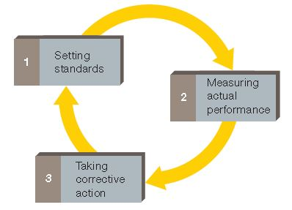
Controlling Ongoing Activities
Controlling is the process of evaluating and regulating ongoing activities to ensure that goals are achieved
Requires constant monitoring and adjusting
Control function
  Set standards
  Measure performance
  Take corrective action
Notes:
Note: Learners can think of controlling in terms of a traffic cop who is constantly evaluating the situation and adjusting traffic flow to meet immediate needs.

Slide 19
Kinds of Managers
Managers can be classified in two ways:
  According to their level within an organization
  According to their area of management
An organization can be thought of as a three-story structure; each story corresponds to one of the three general levels of management:
  Top managers
  Middle managers
  First-line managers

Slide 20
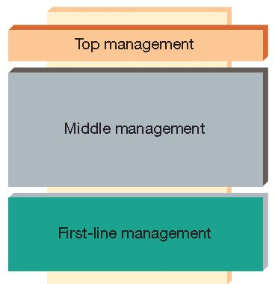
Management Levels: Top Manager
Upper-level executive
Guides and controls the organization’s overall fortunes
Responsible for developing the mission and determining strategy
President, Vice President

Slide 21
Management Levels: Middle Managers
Implements strategy and policies developed by top managers
Develop tactical and operational plans
Coordinate and supervise first-line managers
Division Manager, Department Head, Plant Manger, Operations Manager

Slide 22
Management Levels:
First-Line Managers
Coordinates and supervises operating employees
Spend most of time motivating and working with employees, answering questions, and solving day-to-day problems
Former operating employees who were promoted
Office Manager, Supervisor, Foreman

Slide 23
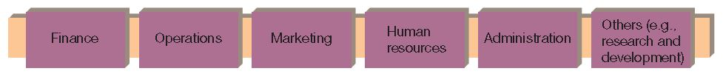
Areas of Management Specialization
Organizational structure can be divided into areas of specialization
Finance
Operations
Marketing
Human Resources
Administration
Other (R&D)

Slide 24
Areas of Management Specialization:
Financial Managers
A financial manager is primarily responsible for an organization’s financial resources
Specialized areas within financial management:
  Accounting
  Investment

Slide 25
Areas of Management Specialization:
Operations Managers
An operations manager manages systems that convert resources into goods and services
Techniques and procedures can be applied to business and non-business activities

Slide 26
Areas of Management Specialization:
Marketing Managers
A marketing manager facilitates the exchange of products between an organization and its customers and clients
Marketing Research, Product Management, Advertising, Promotion, Sales, Distribution

Slide 27

Areas of Management Specialization:
Human Resources Managers
A human resources manager manages a company’s human resources programs
Hiring, training, and evaluating employee performance
Ensures government regulation compliance

Slide 28
Areas of Management Specialization:
Administrative Managers
An administrative manager is also called general manager
Provides overall guidance and leadership
Coordinates other specialized managers

Slide 29
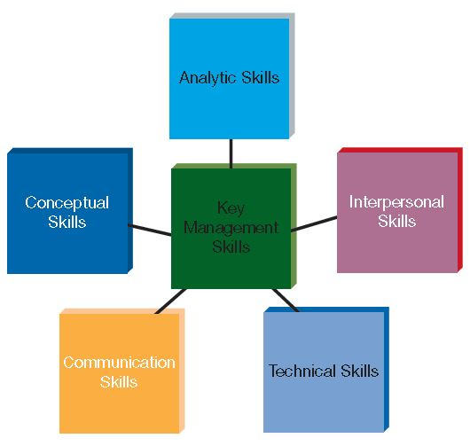
Key Skills of Successful Managers

Slide 30

Key Skills of Successful Managers:
Conceptual Skills
Conceptual skills involve:
  Ability to think in abstract terms
  Help organization see the big picture
  Solicit a wide
  variety of
  viewpoints

Slide 31
Key Skills of Successful Managers:
Analytic Skills
Employers expect managers to use analytic skills to:
  Identify problems
  Prioritize issues
  Recognize underlying reasons
  Generate possible alternatives
  Select the best solution

Slide 32

Key Skills of Successful Managers:
Interpersonal Skills
Interpersonal skills involve:
  Ability to deal effectively with people inside and outside the organization
  Relate to people
  Understand needs
  and motives
  Show genuine compassion

Slide 33
Key Skills of Successful Managers:
Technical Skills
Technical skills involve:
  Specific skills related to the activities they manage
  Train, answer questions, provide guidance and direction
  More important for Middle and First-Line Managers

Slide 34
Key Skills of Successful Managers:
Communication Skills
Communication skills involve:
  Ability to speak, listen, and write effectively
  Technology makes communication both easier and more complex
  Must stay informed and maximize potential of digital communications

Slide 35
Key Skills of Successful Managers
What is the ideal balance
of skills for a manager?
How much does the industry matter?

Slide 36
Class Exercise
For each skill, provide an example of how a manager could use it in a real-world situation.
Technical skill
Conceptual skill
Analytic skill
Communication skill
Interpersonal skill

Slide 37
Leadership
Leadership has been defined broadly as the ability to influence others
Manager vs. Leader:
  A manager may have to depend on coercion
  A leader strives for voluntary cooperation

Slide 38
Formal and Informal Leadership
Formal leaders:
  Have legitimate power of position
  Use their power to influence others to work toward organization’s goals
Informal leaders:
  Do not have legitimate authority
  May not exert their power in support of the firm
  Can be a valuable asset or a dangerous threat

Slide 39
Styles of Leadership: Autocratic
Autocratic leadership is very task-oriented
Little concern for employee opinions
Employees given specific guidelines and rules

Slide 40
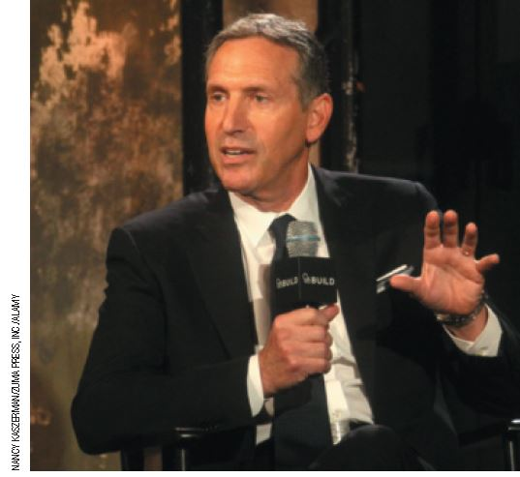
Styles of Leadership: Participative
Participative leadership is common in today’s business organizations
Consults workers before making decisions
Helps workers understand organization’s goals and have sense of ownership
Three groups:
  Consultative
  Consensus
  Democratic

Slide 41
Styles of Leadership: Entrepreneurial
Entrepreneurial leadership is personality dependent
  Task-oriented
  Driven
  Characteristic
  Enthusiastic
  Visionary
  Takes initiative
  Tends to work long hours and may not understand why others don’t have the same passion

Slide 42
Which Leadership Style Is Best?
Effective leadership depends on:
  Interaction among the employees
  Characteristics of the work situation
  The manager’s personality
Consider:
What are some pros and cons of
each management style?
Notes:
An example answer to the question: Participative leadership can motivate employees to work more effectively, but the decision-making process can take time away from the actual task
Additional Resources
Article
Wall Street Journal
Leadership Styles
http://guides.wsj.com/management/developing-a-leadership-style/how-to-develop-a-leadership-style/
Forbes
Leadership Tips, New York Style: Lessons from the NYC MTA
11/14/12
http://www.forbes.com/sites/johnkotter/2012/11/14/leadership-tips-new-york-style-lessons-from-the-nyc-mta/
NY Times
A New Style of Leadership at Panasonic
11/8/12
http://www.nytimes.com/2012/11/09/technology/09iht-panasonic09.html?pagewanted=all&_r=0

Slide 43
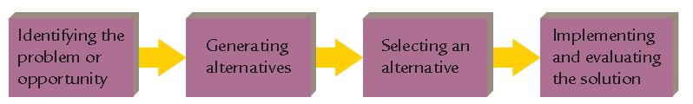
Managerial Decision Making
Decision making is the act of choosing one alternative from a set of alternatives
Managers require a systematic method for solving problems in a variety of situations

Slide 44
Managerial Decision-Making Process:
Identifying the Problem or Opportunity
A problem is the difference between what is actually happening and what you want to happen
A problem can be negative, or it can be viewed as an opportunity
Preconceptions can complicate this step
Effective managers clarify situation, examine causes, and consider how individual behaviors and values affect the way problems and opportunities are defined

Slide 45
Managerial Decision-Making Process:
Generating Alternatives
The more important the decision, the more attention must be devoted to generating alternatives
Managers should be open to fresh, innovative ideas
Sometimes the answer is obvious
Techniques:
  Brainstorming
  Blast! Then Refine
  Trial and Error

Slide 46
Managerial Decision-Making Process:
Selecting an Alternative
Final decisions are based on:
  Financial constraints
  Time limits
  Legal obstacles
  Political factors
  Human and informational resources
Sometimes two or more, or some combination of alternatives is appropriate
Satisfice: solutions that are only adequate and not ideal

Slide 47
Managerial Decision-Making Process:
Implementation and Evaluation
Even with careful planning, managers often deal with unforeseen consequences
A decision is considered effective if it solves the problem or capitalizes on the opportunity
If the problem still exists:
  Give chosen alternative more time
  Adopt a different alternative
  Start the process all over again
Failure to evaluate decisions adequately can cause serious problems for firm, customers, and beyond
Notes:
Additional Resources
Article
Financial Times
Opinion: America Must Face Up to the Dangers of Derivatives
4/22/10
http://www.ft.com/intl/cms/s/0/707ef202-4e3d-11df-b48d-00144feab49a.html#axzz2CoTXglVx
The Economist
Centrally cleared derivatives: Clear and present danger
4/7/12
http://www.economist.com/node/21552217

Slide 48
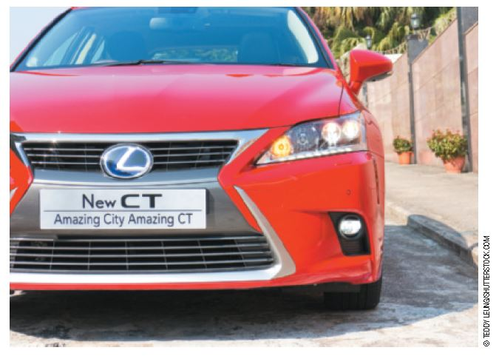
Managing Total Quality
Why focus on management of quality?
  Foreign competition
  More demanding
  customers
  Poor financial
  performance as a
  result of reduced
  market share and higher costs

Slide 49
Total Quality Management (TQM)
Total quality management (TQM) is the coordination of efforts directed at:
  Improving customer satisfaction
  Increasing employee participation
  Strengthening supplier partnerships
  Facilitating an organizational atmosphere of continuous quality improvement
Management must address:
  Customer satisfaction
  Employee participation
  Strengthening supplier partnerships
  Continuous quality improvement
Notes:
Additional Resources
Article
The Economist
Total Quality Management
11/16/09
http://www.economist.com/node/14301657
Scholarly Papers
Academia.edu
Total Quality Management
http://www.academia.edu/Documents/in/Total_Quality_Management_TQM_
Article
Total Quality Management: Panacea or Pitfall
http://centstrat.com/wp-content/uploads/2008/05/tqm-panacea-or-pitfall.pdf

Slide 50
TQM: Benchmarking
Benchmarking is the process of evaluating the products, processes, or management practices of another organization that is superior in some way in order to improve quality
  Identify objectives
  Form a benchmark team
  Collect data
  Analyze data
  Act on results

Slide 51
TQM: Effectiveness
Factors influence the effectiveness:
  Top management must make TQM a priority and give it frequent attention
  Management must coordinate the specific elements of a TQM program so they work together

Slide 52
TQM: Benefits
Lower operating costs
Higher return on sales and investments
Improved ability to use premium pricing
rather than competitive pricing
Savings from preventing future problems and integrating systems makes up for expense
Long-term costs can involve damage to a company’s reputation and lost productivity
and time from fixing mistakes
Notes:
Additional Resources
Article
Bloomberg Businessweek
Toyota's Management Challenge
3/5/10
http://www.businessweek.com/managing/content/mar2010/ca2010034_000939.htm
The Globe and Mail
How Toyota strayed from the quality-control path and lost its way
3/16/10
http://www.theglobeandmail.com/report-on-business/rob-commentary/how-toyota-strayed-from-the-quality-control-path-and-lost-its-way/article4325675/
MIT Sloan Management Review
What Really Happened to Toyota?
6/22/11
http://sloanreview.mit.edu/the-magazine/2011-summer/52417/what-really-happened-to-toyota/

